Slide 1
Lecture 2 (cont): Applied Quantum Mechanics

Slide 2
So far, we have learned:
…what the Schrödinger equation is, and how to use the wave-function
…how to solve the SE in 1D and how to interpret the result, encountering discrete energies, confinement, uncertainty relation, mixed states, …
…that the Hydrogen atom is solvable, and its solution forms the famous “orbitals”
…that we can express the many-body wave-function in terms of a 1-particle wave-function, which we expand into basis functions, and then find eigenstates from the eigensystem problem
…that there exist semi-empirical methods, such as Hückel theory, that allows us to approximately solve the SE in complex systems, such as molecules
…but is there a way to solve the SE from first principles, with minimal empiricism?
…and how do we compute forces on atoms, so that we may propagate them in time?

Slide 3

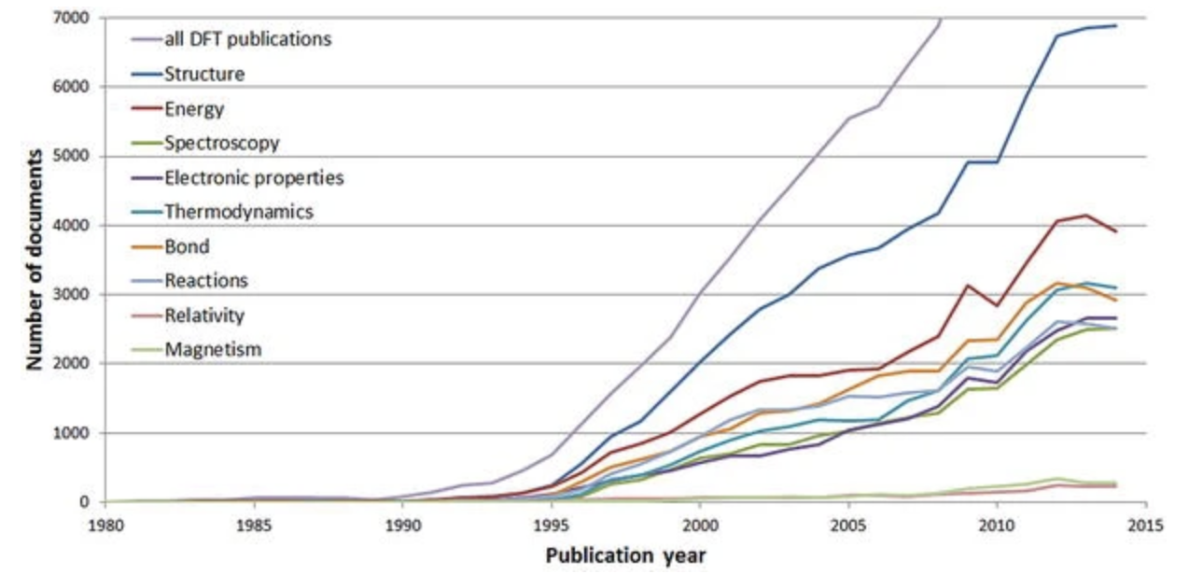
Density functional theory
The Nobel Prize in Chemistry 1998 was divided equally between Walter Kohn "for his development of the density-functional theory" and John A. Pople "for his development of computational methods in quantum chemistry"
R. Haunschild et al. (2016), Journal of Cheminformatics 8: 52

Slide 4

Density functional theory
“It’s a cat!”
“It’s a cat!”
To map a complex system to a simple system.
interacting electrons → non-interacting electrons
Courtesy of Pui-Wai (Leo) Ma

Slide 5
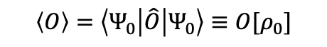
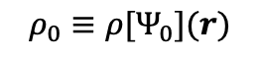
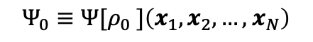
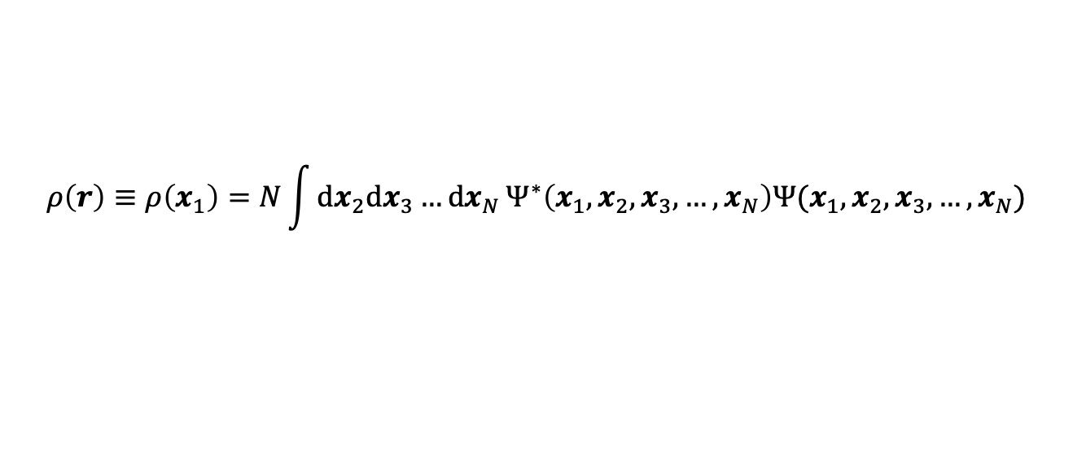
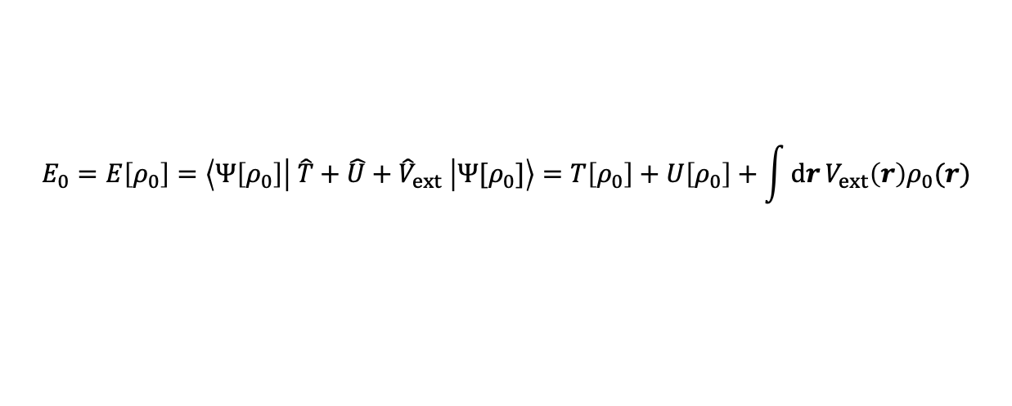
The Hohenberg-Kohn theorems
P. Hohenberg and W. Kohn (1964), Phys. Rev. 136: B864
1st H-K theorem: Let $Ψ_{0}\left(x\right), r∈ℝ^{3N}$, be an $N$-body WF in the ground state. There exists a unique corresponding electron density $ρ\left(r\right), r∈ℝ^{3}$, that has identical properties, defined as:
$$ρ\left(r\right)≡ρ\left(x_{1}\right)=N\int{dx_{2}dx_{3}…dx_{N}}Ψ^{∗}\left(x_{1},x_{2},x_{3},…,x_{N}\right)Ψ(x_{1},x_{2},x_{3},…,x_{N})$$
Given this uniqueness, the WF may be expressed as dependent on the density function, and the other way around:
$$Ψ_{0}≡Ψ[ρ_{0} ]\left(x_{1},x_{2},…,{ x}_{N}\right)$$
$$ρ_{0}≡ρ[Ψ_{0}](r)$$
Therefore, the expected value of an observable of the ground-state is also a functional of the density:
$$\left\langle O\right\rangle =\left\langle Ψ_{0}\left|\hat{O}\right|Ψ_{0}\right\rangle ≡O[ρ_{0}]$$
2nd H-K theorem: The ground-state density is the one minimising the total energy functional.
However, do note that we have not yet discovered any exact closed-form expressions for $T\left[ρ\right]$ or $U\left[ρ\right]$!
$$E_{0}=E\left[ρ_{0}\right]=\left\langle Ψ\left[ρ_{0}\right]\left| \hat{T}+\hat{U}+{\hat{V}}_{ext} \right|Ψ[ρ_{0}]\right\rangle =T\left[ρ_{0}\right]+U\left[ρ_{0}\right]+\int{dr}V_{ext}\left(r\right)ρ_{0}(r)$$
kinetic energy
e-e repulsion & Pauli exclusion
e-nuclei attraction

Slide 6

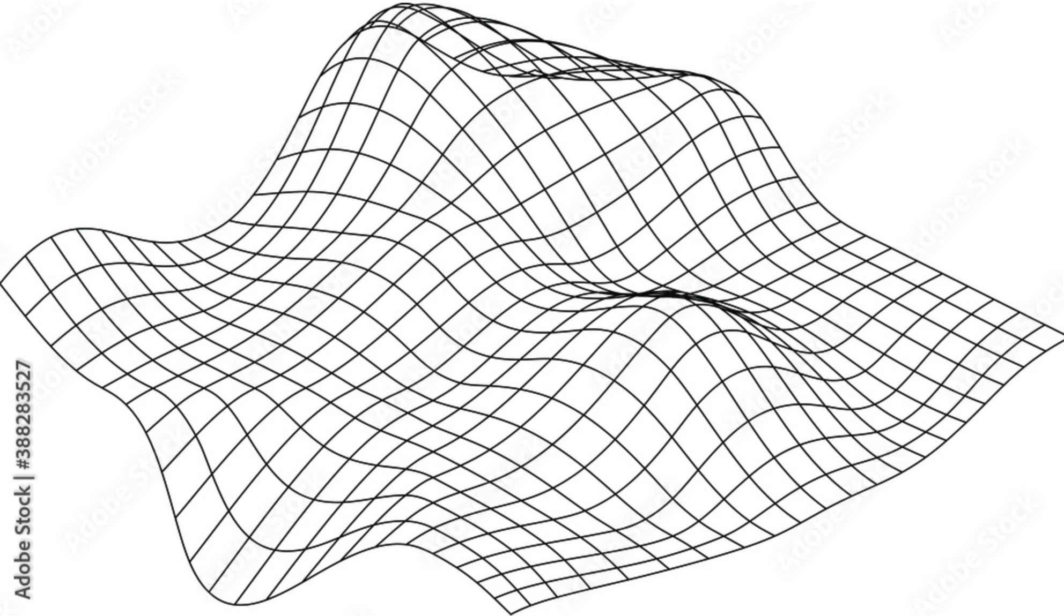
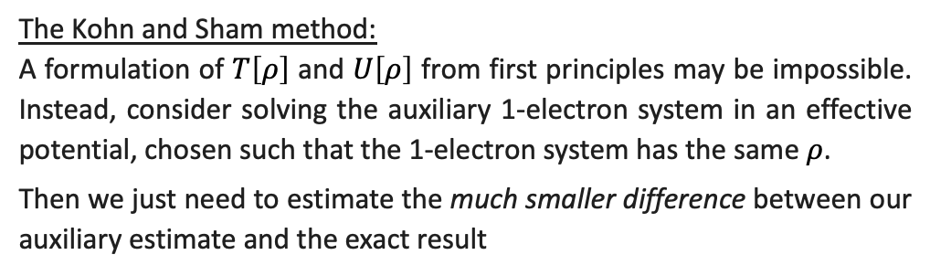
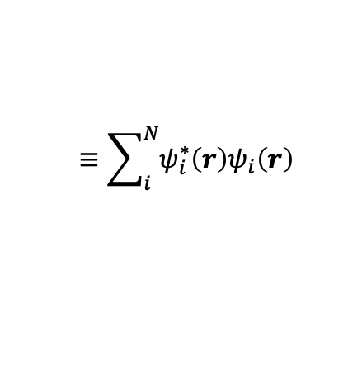
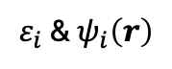
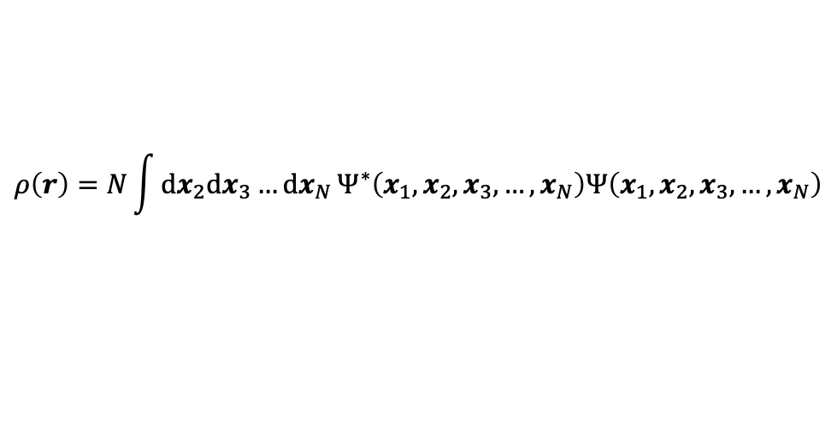
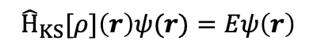




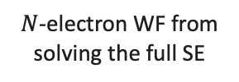
The Kohn-Sham equations
W. Kohn and L. J. Sham (1965), Phys. Rev. 140: 4A
Using the H-K theorems, we reduced the dimensionality from $3N$ to $3$. But do the functionals $T\left[ρ\right]$ and $U\left[ρ\right]$ exist in a form that can be derived or expressed analytically? This is an active area of research, and thus materials are modelled differently today.
The Kohn and Sham method:
A formulation of $T\left[ρ\right]$ and $U\left[ρ\right]$ from first principles may be impossible. Instead, consider solving the auxiliary 1-electron system in an effective potential, chosen such that the 1-electron system has the same $ρ$.
Then we just need to estimate the much smaller difference between our auxiliary estimate and the exact result
$N$-electron system
1-electron auxiliary system
electrons
$$ρ\left(r\right)=N\int{dx_{2}dx_{3}…dx_{N}}Ψ^{∗}\left(x_{1},x_{2},x_{3},…,x_{N}\right)Ψ\left(x_{1},x_{2},x_{3},…,x_{N}\right)$$
$$ρ(r)$$
$$ρ(r)$$
$$≡\sum_{i}^{N}{ψ_{i}^{∗}{\left(r\right)ψ}_{i}\left(r\right)}$$
effective potential
$N$-electron WF from solving the full SE
$$v_{eff}[ρ]\left(r\right)$$
$1$-electron “Kohn-Sham” orbitals from solving auxiliary SE eigenproblem
$${\hat{H}}_{KS}[ρ]\left(r\right)ψ(r)=Eψ\left(r\right)$$
$ε_{i}$ & $ψ_{i}\left(r\right)$

Slide 7

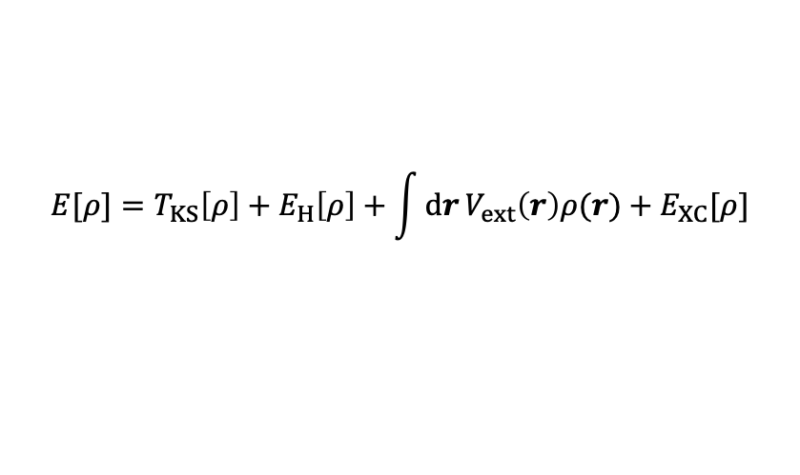
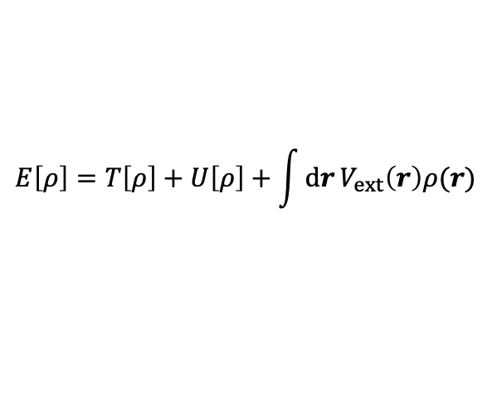

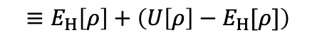
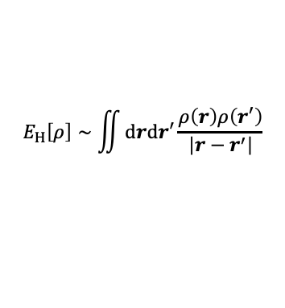
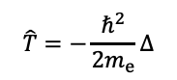


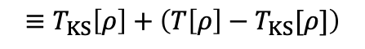

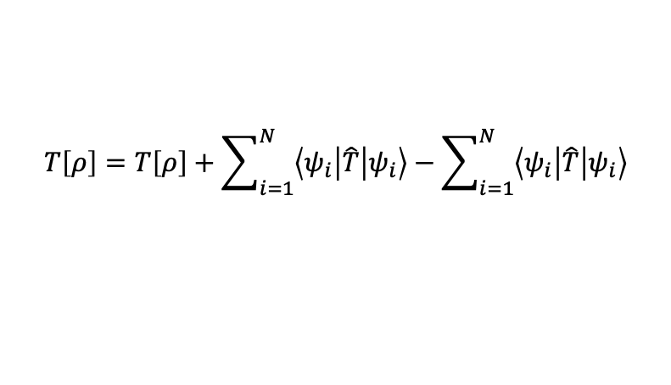

The Kohn-Sham equations
W. Kohn and L. J. Sham (1965), Phys. Rev. 140: 4A
The Kohn and Sham method:
How do we obtain the effective potential for the 1-electron system? Recall the H-K theorem.
$$E\left[ρ\right]=T\left[ρ\right]+U\left[ρ\right]+\int{dr}V_{ext}\left(r\right)ρ(r)$$
$$\hat{T}=−\frac{ℏ^{2}}{2m_{e}}Δ$$
$N$-electron system
1-electron auxiliary system
$$T\left[ρ\right]=T\left[ρ\right]+\sum_{i=1}^{N}{\left\langle ψ_{i}\left|\hat{T}\right|ψ_{i}\right\rangle }−\sum_{i=1}^{N}{\left\langle ψ_{i}\left|\hat{T}\right|ψ_{i}\right\rangle }$$
$$≡T_{KS}\left[ρ\right]+\left(T\left[ρ\right]−T_{KS}[ρ]\right)$$
electrons
$$U\left[ρ\right]=U\left[ρ\right]+E_{H}\left[ρ\right]−E_{H}[ρ]$$
classical Coulomb energy
$$E_{H}\left[ρ\right]∼\iint{drdr^{′}}\frac{ρ\left(r\right)ρ\left(r^{′}\right)}{\left|r−r^{′}\right|}$$
$$ρ(r)$$
$$ρ(r)$$
$$≡E_{H}\left[ρ\right]+\left(U\left[ρ\right]−E_{H}[ρ]\right)$$
effective potential
$$E[ρ]=T_{KS}\left[ρ\right]+E_{H}\left[ρ\right]+\int{dr}V_{ext}\left(r\right)ρ(r)+E_{XC}[ρ]$$
$$v_{eff}[ρ]\left(r\right)$$
given $ρ$ and $ψ$ we can evaluate this easily
is unknown
The “Exchange-correlation” energy contains all the correlated, many-electron contributions that are undetermined…
But relative to the effective single-electron energy , it is a smaller correction!
$$E_{XC}[ρ]=\left(T\left[ρ\right]−T_{KS}[ρ])+(U[ρ]−E_{H}[ρ]\right)$$

Slide 8
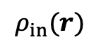

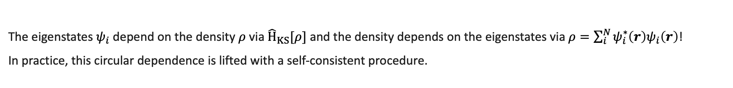




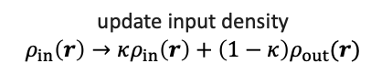
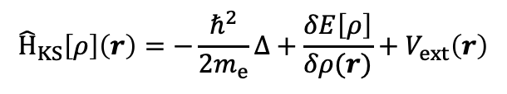
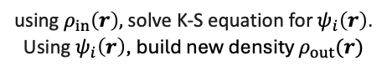
The Kohn-Sham equations
W. Kohn and L. J. Sham (1965), Phys. Rev. 140: 4A
Assume for now that we can somehow estimate $E_{XC}\left[ρ\right]$. We still need to solve for the Kohn-Sham equation for the ground-state.
$${\hat{H}}_{KS}\left[ρ\right]\left(r\right)=−\frac{ℏ^{2}}{2m_{e}}Δ+\frac{δE\left[ρ\right]}{δρ(r)}+V_{ext}\left(r\right)$$
The K-S equation is derived by minimising $E\left[ρ\right]$ w.r.t. $ψ_{i}(r)$
$${\hat{H}}_{KS}\left[ρ\right]\left(r\right) ψ(r)=Eψ(r)$$
where
The eigenstates $ψ_{i}$ depend on the density $ρ$ via ${\hat{H}}_{KS}[ρ]$ and the density depends on the eigenstates via $ρ=\sum_{i}^{N}{ψ_{i}^{∗}{\left(r\right)ψ}_{i}\left(r\right)}$!
In practice, this circular dependence is lifted with a self-consistent procedure.
Late comment: We show here a linear mixing scheme. Someone raised a good question: why does a simple mixing of the electron density lead towards convergence? Ordinarily, one might use some kind of gradient descent. Why is this not necessary here? I believe linear mixing is related to the assumption that the dielectric response is an isotropic matrix?
trial input density
using $ρ_{in}\left(r\right),$solve K-S equation for $ψ_{i}\left(r\right)$.
Using $ψ_{i}\left(r\right)$, build new density $ρ_{out}(r)$
$$ρ_{in}(r)$$
if $ρ_{out}≈ρ_{in}$
self-consistent field
if $ρ_{out}≠ρ_{in}$
$ρ_{out}$ is the ground-state density!
update input density
$$ρ_{in}\left(r\right)→κρ_{in}\left(r\right)+\left(1−κ\right)ρ_{out}(r)$$

Slide 9

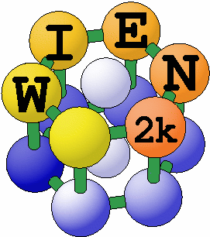






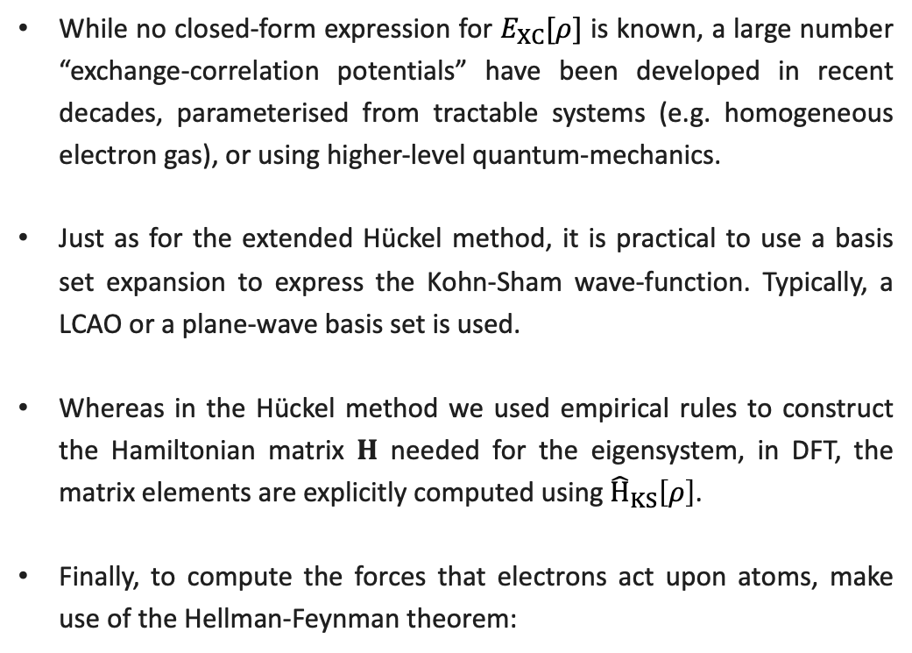
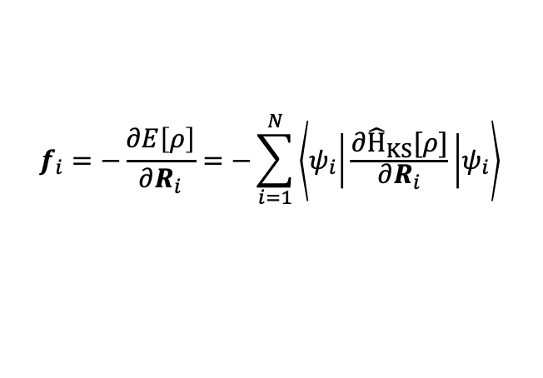
DFT practical remarks I
The zoology of XC-potentials
While no closed-form expression for $E_{XC}[ρ]$ is known, a large number “exchange-correlation potentials” have been developed in recent decades, parameterised from tractable systems (e.g. homogeneous electron gas), or using higher-level quantum-mechanics.
Just as for the extended Hückel method, it is practical to use a basis set expansion to express the Kohn-Sham wave-function. Typically, a LCAO or a plane-wave basis set is used.
Whereas in the Hückel method we used empirical rules to construct the Hamiltonian matrix $H$ needed for the eigensystem, in DFT, the matrix elements are explicitly computed using ${\hat{H}}_{KS}\left[ρ\right]$.
Finally, to compute the forces that electrons act upon atoms, make use of the Hellman-Feynman theorem:
Some commonly used DFT codes
$$f_{i}=−\frac{∂E\left[ρ\right]}{∂R_{i}}=−\sum_{i=1}^{N}{\left\langle ψ_{i} | \frac{∂{\hat{H}}_{KS}[ρ]}{∂R_{i}} | ψ_{i}\right\rangle }$$

Slide 10
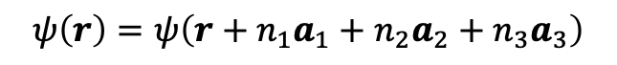
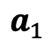
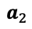
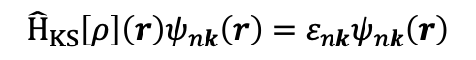
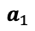
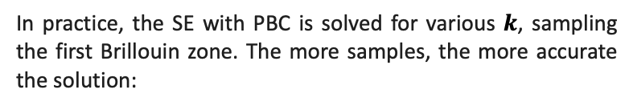
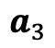

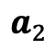

DFT practical remarks II
Systems relevant for materials science are often crystalline, or otherwise spatially extended
To effectively simulate an infinite system, we use periodic boundary conditions. For example, see a periodic crystal:
periodic wave-function
$$ψ\left(r\right)=ψ\left(r+n_{1}a_{1}+n_{2}a_{2}+n_{3}a_{3}\right)$$
triclinic unit cell with 2 atoms
and primitive lattice vectors a,b,c
2D illustration
$$n_{i}∈\{…,−2,−1,0,1,2,…\}$$
Bloch’s theorem: solutions to the SE in a periodic potential can be expressed as plane waves modulated by periodic functions:
$$a_{3}$$
$$a_{2}$$
$$ψ\left(r\right)=e^{ik⋅r}u(r)$$
$$a_{1}$$
In practice, the SE with PBC is solved for various $k$, sampling the first Brillouin zone. The more samples, the more accurate the solution:
$$a_{2}$$
$$a_{1}$$
periodic image
original cell
$${\hat{H}}_{KS}\left[ρ\right]\left(r\right)ψ_{nk}\left(r\right)=ε_{nk}ψ_{nk}\left(r\right)$$
eigenstate “band” index
reciprocal space index

Slide 11

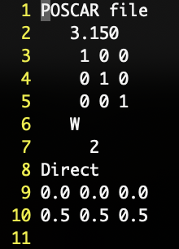

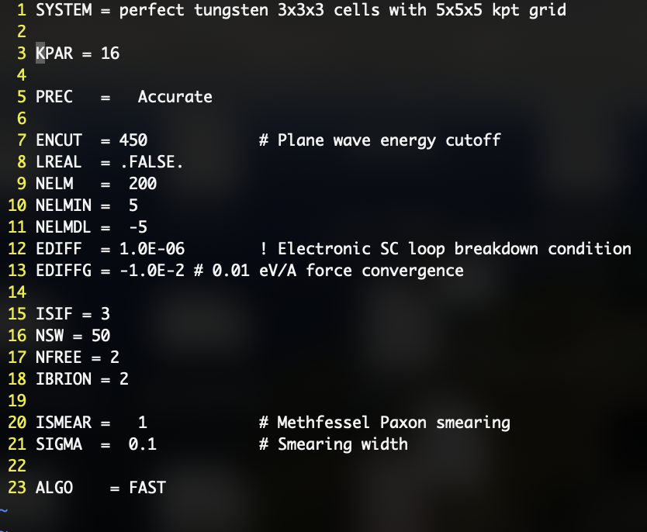
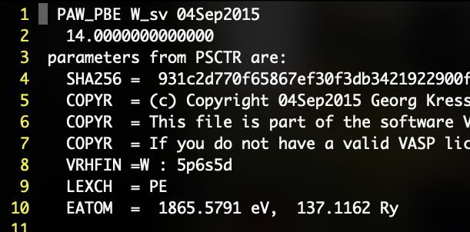
DFT in VASP: Example for tungsten
Determining lattice constant in a BCC unit cell, 2 atoms
POSCAR
KPOINTS
INCAR
POTCAR
…

Slide 12
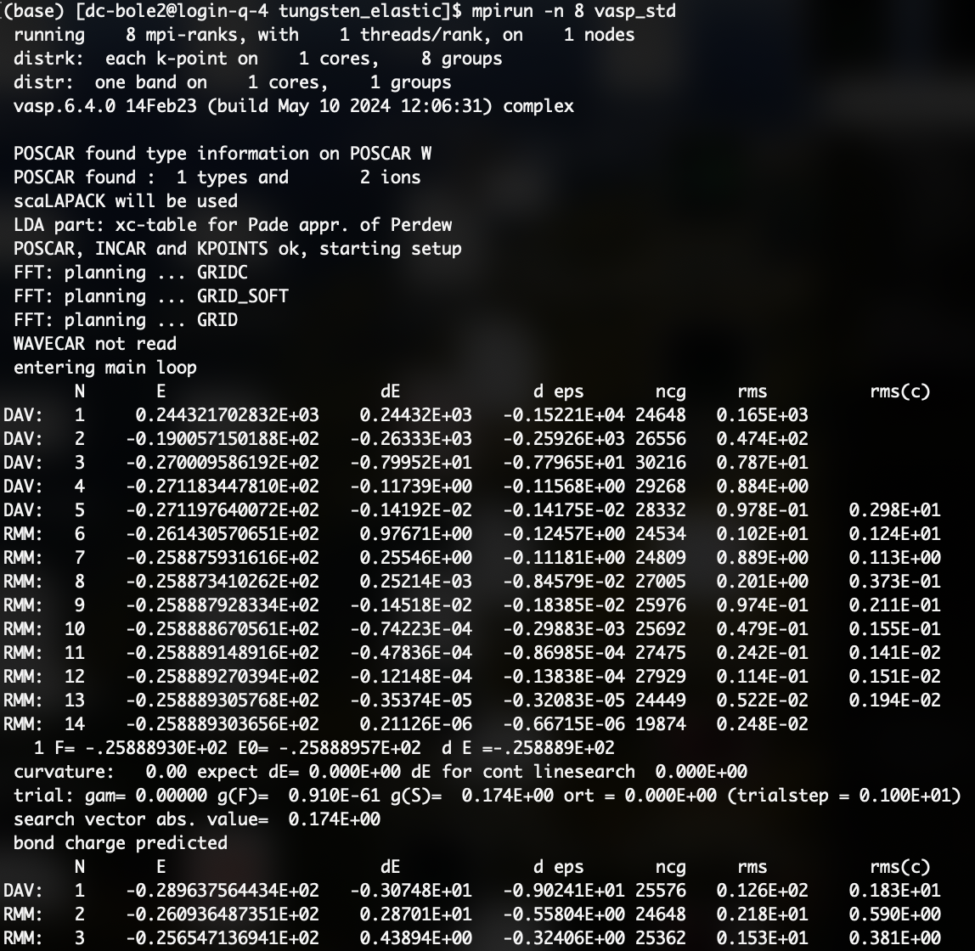
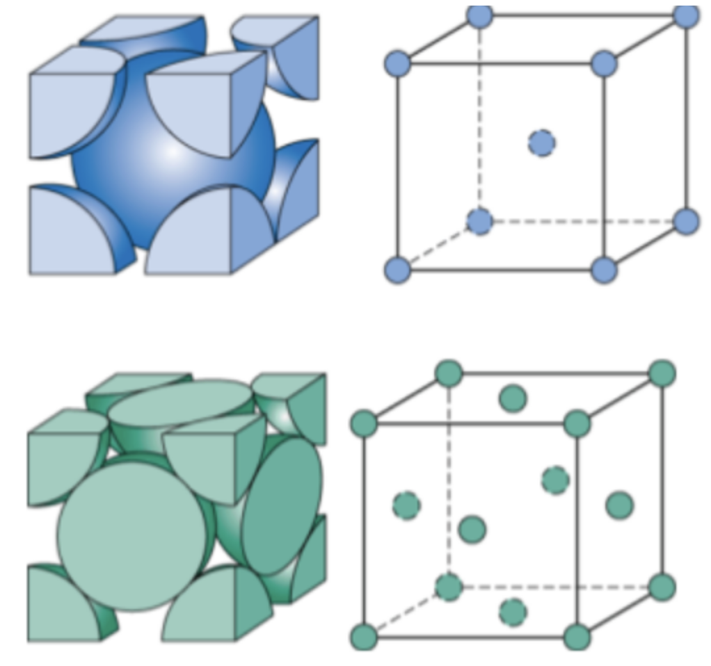
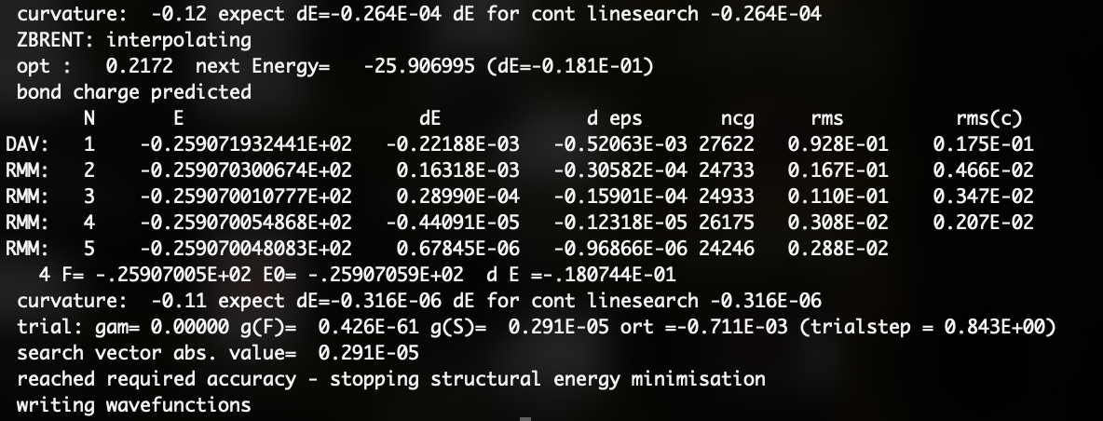
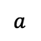
a_{ini} = 3.15
a_{opt} = 3.18552845
$$a$$
a_{exp} = 3.165
The only input for this calculation was:
initial unit cell structure
choice of the XC potential (PBE)
various settings for calculation accuracy
…
A different XC-functional, “AM05”, would predict:
a_{opt} = 3.149

Slide 13
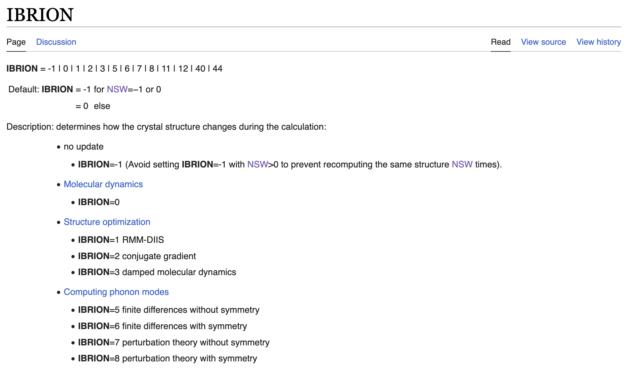
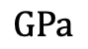
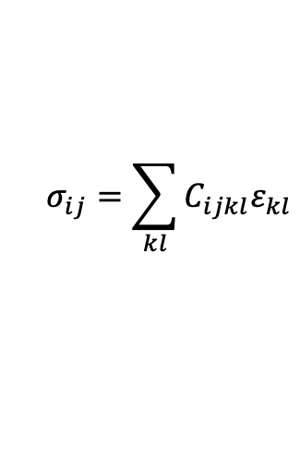
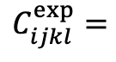
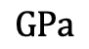
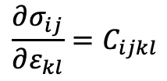
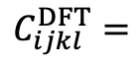
Once we have obtained an accurate lattice constant, we can calculate the elastic constants for tungsten, for example using a finite difference scheme:
$$σ_{ij}=\sum_{kl}{C_{ijkl}ε_{kl}}$$
distort lattice vectors to generate strain and record the resulting stress. Apply finite differences to compute stress gradient w.r.t. strain
change to 6
$$\frac{∂σ_{ij}}{∂ε_{kl}}=C_{ijkl}$$
As expected, bcc tungsten is elastically isotropic.
https://www.vasp.at/wiki/index.php/IBRION
518.3 | 199.8 | 199.8 | 0 | 0 | 0
199.8 | 518.3 | 199.8 | 0 | 0 | 0
199.8 | 199.8 | 518.3 | 0 | 0 | 0
0 | 0 | 0 | 142.1 | 0 | 0
0 | 0 | 0 | 0 | 142.1 | 0
0 | 0 | 0 | 0 | 0 | 142.1
522.4 | 204.4 | 204.4 | 0 | 0 | 0
204.4 | 522.4 | 204.4 | 0 | 0 | 0
204.4 | 204.4 | 522.4 | 0 | 0 | 0
0 | 0 | 0 | 160.6 | 0 | 0
0 | 0 | 0 | 0 | 160.6 | 0
0 | 0 | 0 | 0 | 0 | 160.6
$$C_{ijkl}^{DFT}=$$
$$GPa$$
$$C_{ijkl}^{exp}=$$
$$GPa$$
Voigt notation

Slide 14
Lecture 3: Materials properties from atoms

Slide 15
Equilibrium crystal structure
DFT is, in essence, an assumption-free method. As such, it is ideally situated for solving questions of fundamental nature that require high accuracy.
Just by being able to compute energies, we can determine the equilibrium crystal phase of a material:

Slide 16

Equilibrium crystal structure
DFT is, in essence, an assumption-free method. As such, it is ideally situated for solving questions of fundamental nature that require high accuracy.
Just by being able to compute energies, we can determine the equilibrium crystal phase of a material:
Create a unit cell of a given crystal structure (base-centered cubic, face-centered cubic, hexagonal close-packed, ...)
Compute the total energy of each crystal structure with DFT, repeating the simulations over a range of lattice constants
The structure with the overall lowest energy is the equilibrium crystal structure at absolute zero temperature*.
pure Fe
J. Neugebauer and T. Hickel (2013), Comput. Molec. Sci. 3 (5): 438-448

Slide 17
Equilibrium crystal structure
DFT is, in essence, an assumption-free method. As such, it is ideally situated for solving questions of fundamental nature that require high accuracy.
Just by being able to compute energies, we can determine the equilibrium crystal phase of a material:
Create a unit cell of a given crystal structure (base-centered cubic, face-centered cubic, hexagonal close-packed, ...)
Compute the total energy of each crystal structure with DFT, repeating the simulations over a range of lattice constants
The structure with the overall lowest energy is the equilibrium crystal structure at absolute zero temperature*.
pure Fe
bcc
fcc
J. Neugebauer and T. Hickel (2013), Comput. Molec. Sci. 3 (5): 438-448

Slide 18



Equilibrium crystal structure
A similar method can also be applied to determine the structures of molecular crystals, but the atomic degrees of freedom must also be minimised; the search space is much more complex.
Poly(3-hexylthiophene-2,5-diyl)
M. Rivera, https://m-rivera.github.io/research
M. Boleininger (2017), Imperial College London

Slide 19





Defect properties
Crystals are rarely perfect. When crystals are irradiated, atoms are knocked out of their lattice sites, leaving behind vacant sites (=vacancy) from where they depart. Where the atoms come to rest, they may wedge themselves between the lattice sites (=self-interstitial).
Crystal defects diffuse thermally and undergo reactions, changing the material’s microstructure and thus properties.
For nuclear materials, we need to know what types of defects are generated, and how they subsequently evolve
Using DFT, we can calculate formation energies and elastic properties to predict which defects are most likely to be generated
$$ΔV_{int}+ΔV_{vac}≈1.1 V_{atom}$$
scattered
high-energy
particle

Slide 20




Defect properties
The formation energy quantifies the energy required to generate a defect relative to a pristine crystal.
Some defects add or remove atoms. Make sure to correct for a differences in the number of atoms!
And for elastic effects…
$$E_{formation}=E_{total}\left(defective\right)−E_{total}\left(pristine\right)×\frac{N_{atoms}\left(defective\right)}{N_{atoms}\left(pristine\right)}$$
$$+ E_{corrections}$$
Example: mono-vacancy formation energy in tungsten computed with DFT (VASP)
 | pristine | defect
$$N_{atoms}$$ | 128 | 127
$$E_{total} (eV)$$ | -1658.1268 | -1641.9248
DFT settings:
PBE with 5p6s5d
4x4x4 unit cell
5x5x5 k-points
450 eV cutoff
$$E_{formation}=−1641.9248 eV−\left(−1658.1268 eV\right)×\frac{127}{128}=3.248 eV$$
Iso-surface scan through the electron density

Slide 21


Defect properties
In the 1970s, it was hotly debated what the most stable interstitial defect configuration in BCC transition metals is. In 2006-2007, DFT calculations demonstrated it to be the <111> “crowdion” configuration (exceptions: Fe & Cr)
D. Nguyen-Manh et al. (2006), PRB 73: 020101
P. M. Derlet et al. (2007), PRB 76.5: 054107

Slide 22



Excited states in DFT
It is possible to formulate an equivalent Hohenberg-Kohn theorem for a time-dependent system (TD-DFT).
If the nuclear potential is suddenly perturbed, we see the following response in the electron density:
$$V_{ext}\left(r,t\right)=V_{ext}^{(0)}\left(r\right)+Θ(t)V_{ext}^{(1)}\left(r\right)$$
$ρ\left(r,t\right)=ρ_{KS}\left(r\right)+ρ^{(1)}(r,t)+ρ^{(2)}(r,t)$ $+ρ^{\left(3\right)}\left(r,t\right)+…$
$$ρ^{\left(1\right)}\left(r,ω\right)=\int{dr′} χ\left(r,r^{′},ω\right)V_{ext}^{\left(1\right)}(r^{′},ω)$$
the poles of the response function represent excited states
If a stronger perturbation needs to be simulated, we can also explicitly propagate the time-dependent Kohn-Sham equation (time-propagated DFT).
Using these techniques, we can compute:
Excitation energies, photoabsorption spectra, magnetic and electric field response, frequency-dependent polarizabilities, …
M. Boleininger and A.P. Horsfield (2017), JCP 147.4

